Slide 1
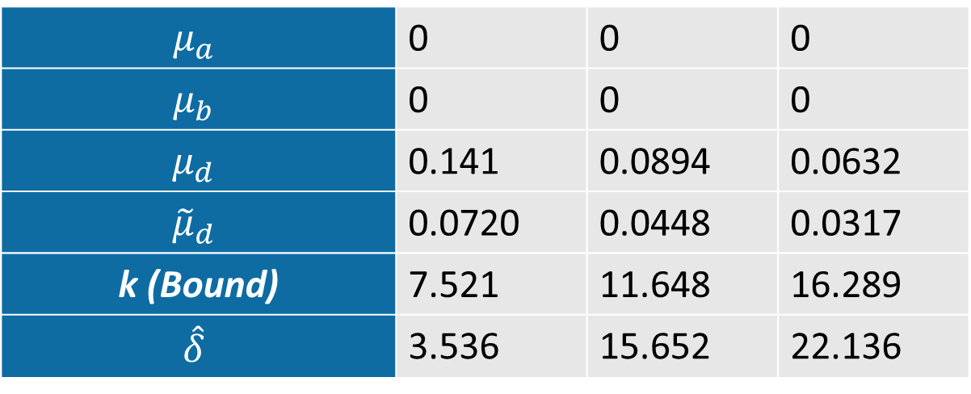
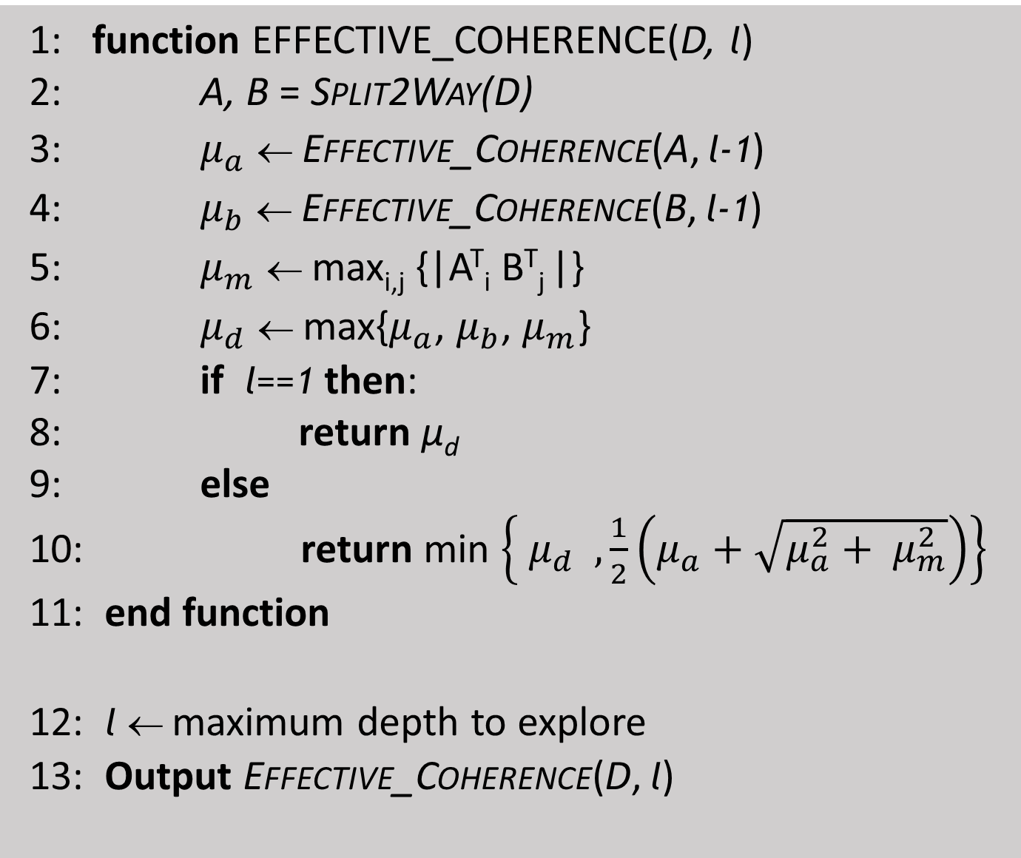
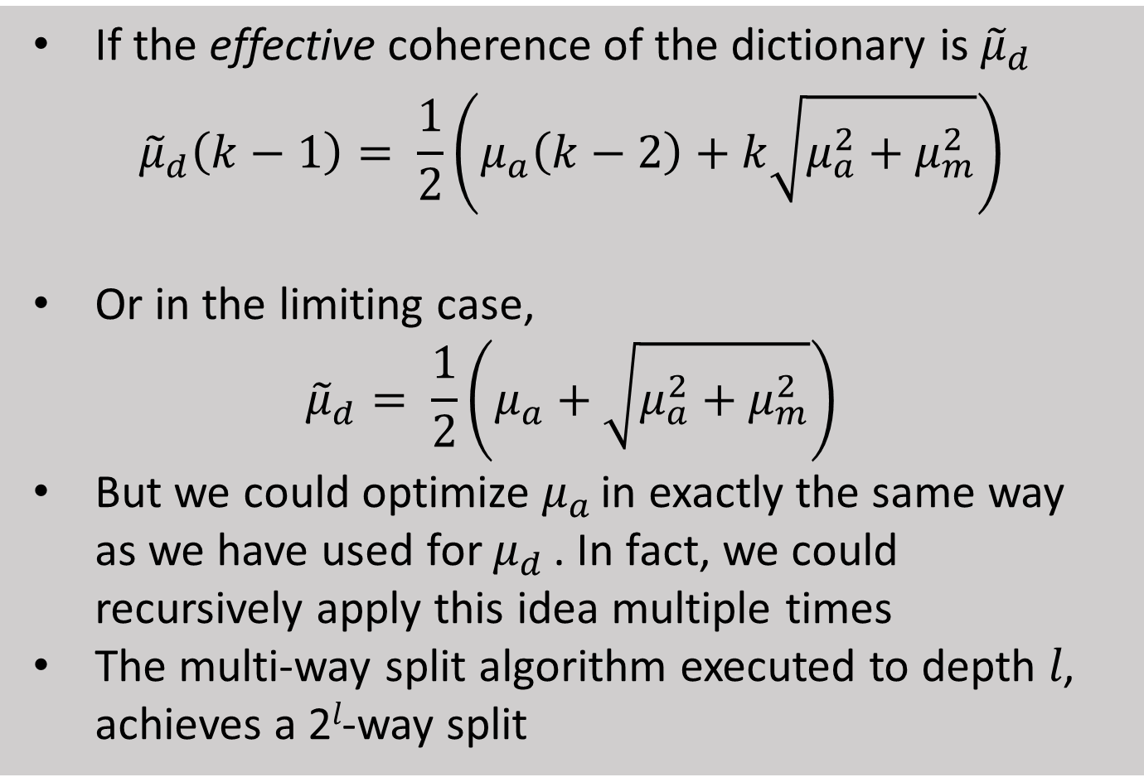
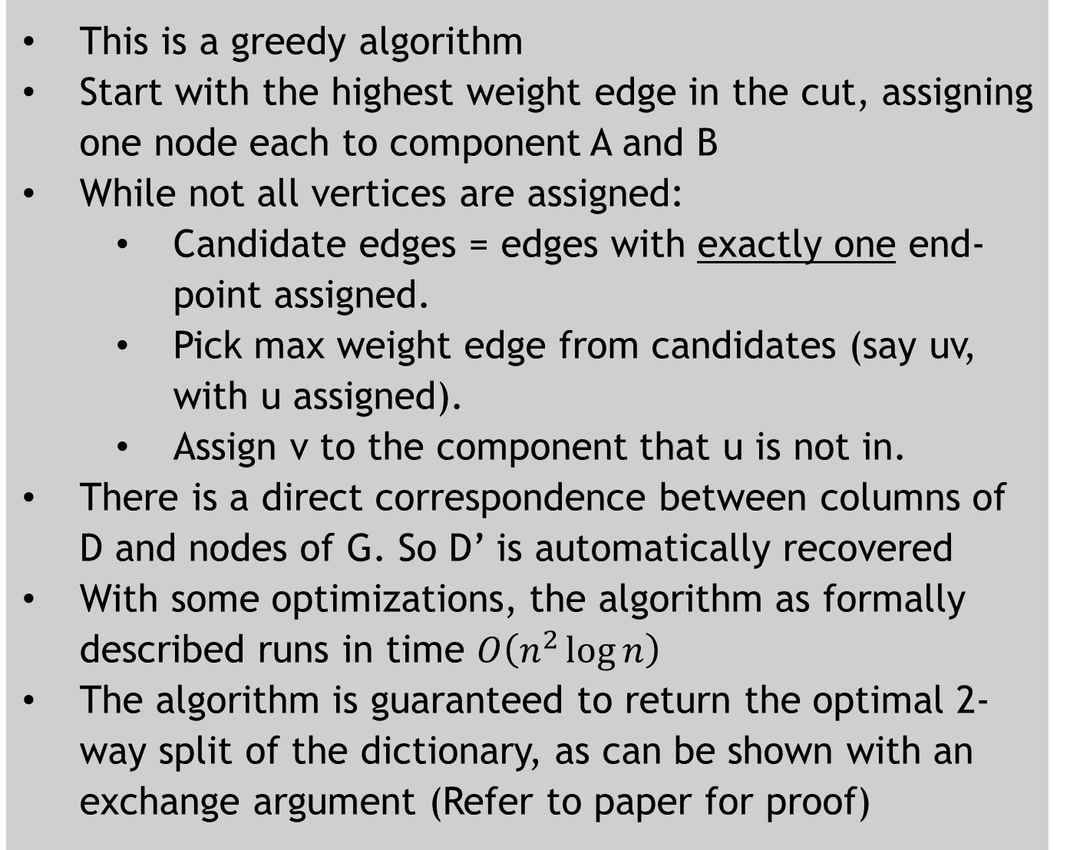
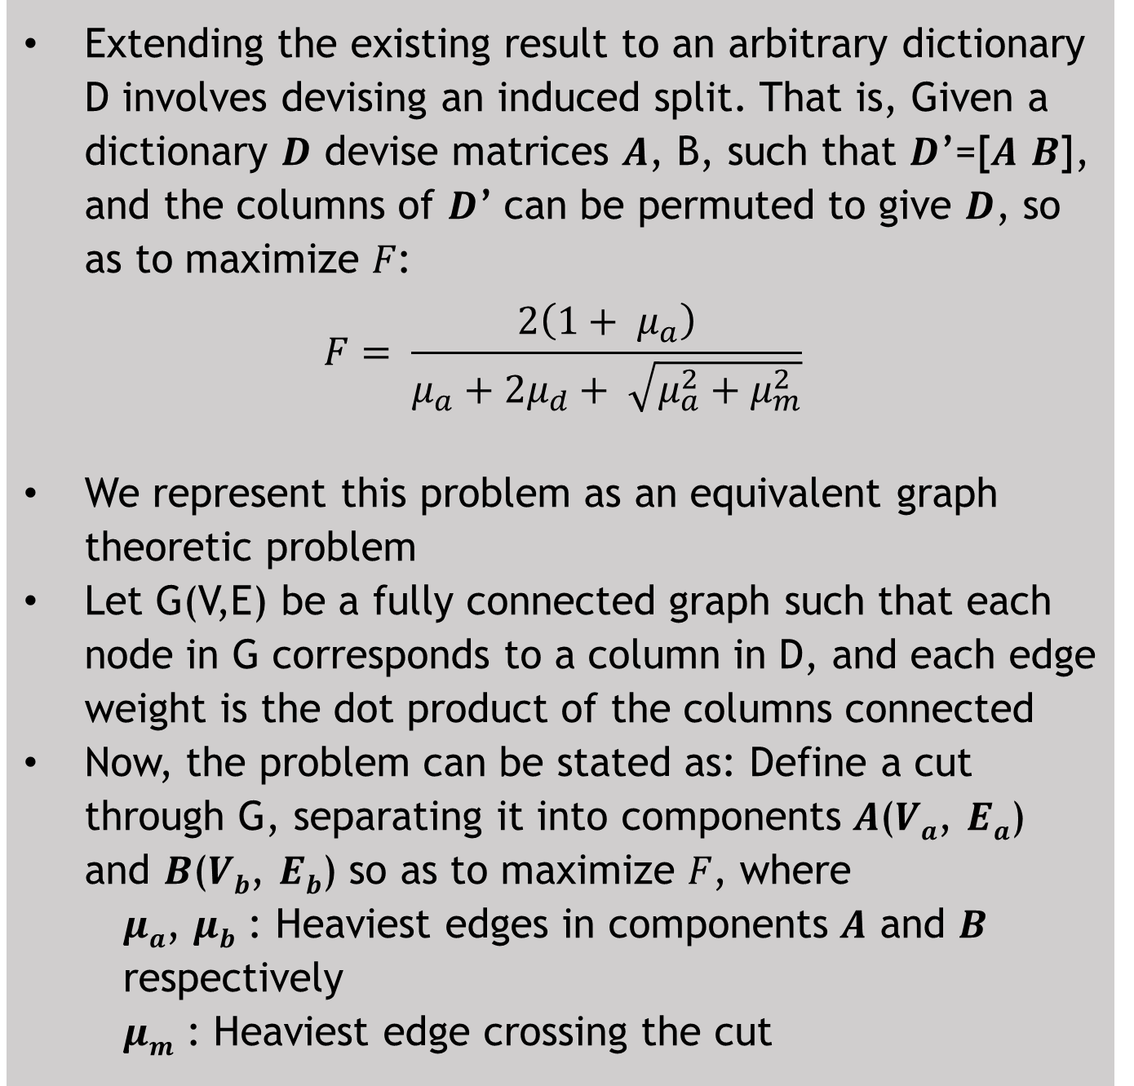
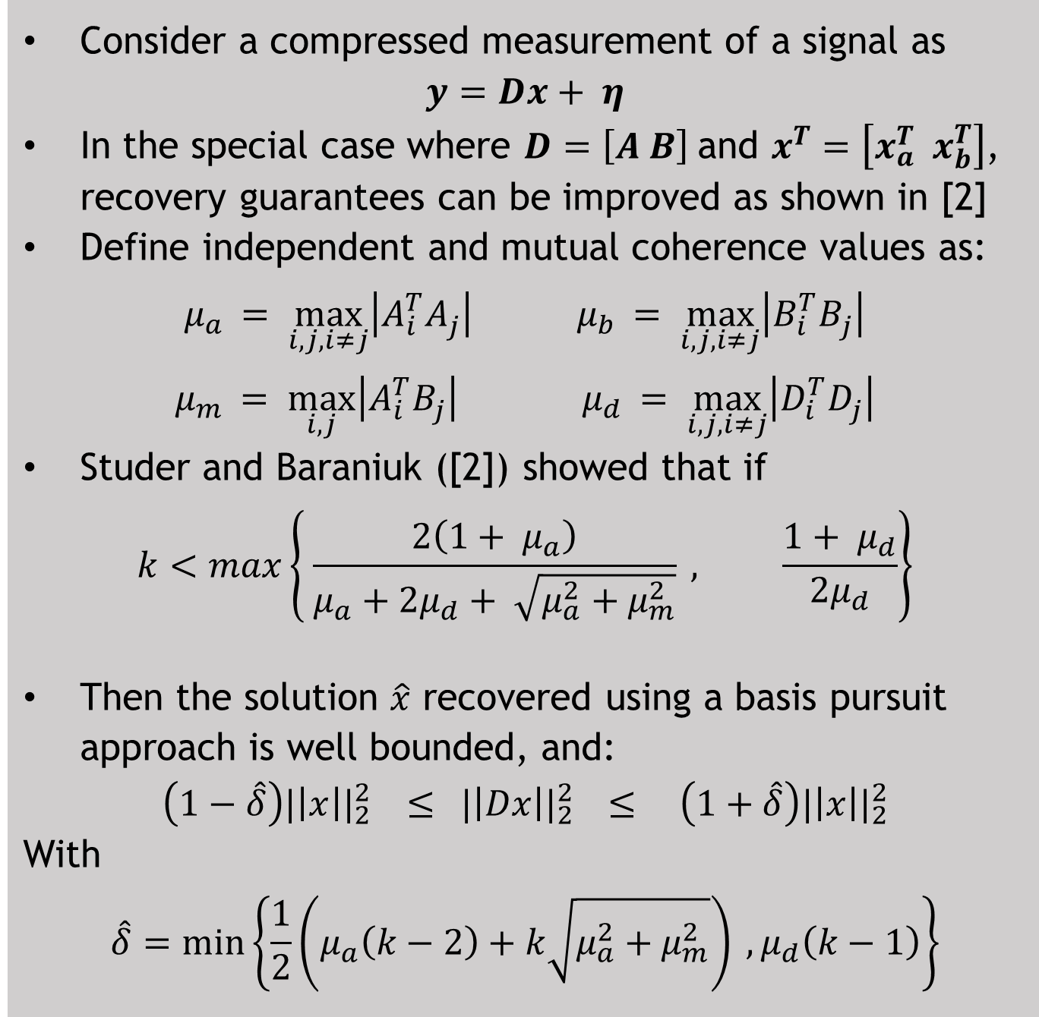
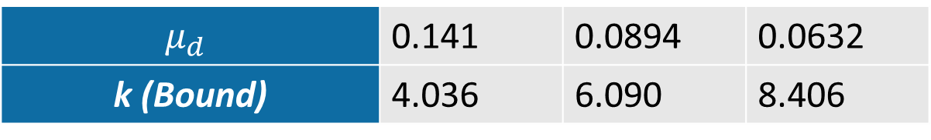
Stronger Recovery Guarantees for Sparse Signals Exploiting Coherence Structure in Dictionaries
Eeshan Malhotra Karthik Gurumoorthy Ajit Rajwade
Indian Institute of Technology Bombay International Centre for Theoretical Sciences, TIFR Indian Institute of Technology Bombay
Introduction
Key Ideas in Dictionary Splitting
Algorithm – 2-Way Split - Formal
Algorithm – Multi-Way Split
Simulated Results
Signals that are sparse or compressible in some general basis (dictionary) can be recovered from significantly fewer measurements than the signal length (compressive sensing)
Coherence-based recovery bounds for these exist, but are conservative
Improved bounds characterize as a concatenation of two sub-parts
We extend the result to arbitrary dictionaries, by devising the optimal artificially induced split in the dictionary
A recursive algorithm also provides a heuristic to improve bounds even further, inducing a multi-way split in the dictionary
The recovery algorithm is unchanged
Extending the existing result to an arbitrary dictionary D involves devising an induced split. That is, Given a dictionary 𝑫 devise matrices 𝑨, B, such that 𝑫’=[𝑨 𝑩], and the columns of 𝑫’ can be permuted to give 𝑫, so as to maximize 𝐹:
$$F= \frac{2\left(1+ μ_{a}\right)}{μ_{a}+{2μ}_{d}+ \sqrt{μ_{a}^{2}+μ_{m}^{2}}}$$
We represent this problem as an equivalent graph theoretic problem
Let G(V,E) be a fully connected graph such that each node in G corresponds to a column in D, and each edge weight is the dot product of the columns connected
Now, the problem can be stated as: Define a cut through G, separating it into components 𝑨(𝑽_{𝒂}, 𝑬_{𝒂}) and 𝑩(𝑽_{𝒃}, 𝑬_{𝒃}) so as to maximize 𝐹, where
𝝁_{𝒂}, 𝝁_{𝒃} : Heaviest edges in components 𝑨 and 𝑩 respectively
𝝁_{𝒎} : Heaviest edge crossing the cut
1: for v ϵ V do:
2: colour(v) ← 0
3: L(v) ← edges from v, in decreasing order of weight
4: end for
5: E_{x} = cut edges ← φ
6: Q = list of edges to process ← φ
7: processed ← φ
8: e = uv ← heaviest edge in G
9: colour(u) ← 1
10: L(u) ← L(u) \ {e}
11: Q ← L(u)
12: processed ← u
13: while size(processed) < n do:
14: if one of {u, v} (say v) is s.t. colour(v) == 0 then:
15: if colour(u) == 1 then colour(v) ← 2
16: if colour(u) == 2 then colour(v) ← 1
17: L(v) ← L(v) \ {e}
18: Merge L(v) into Q
19: processed ← processed ∪ {v}
20: end if
21: if colour(u) != colour(v) then E_{x} ← E_{x} ∪ {e}
22: e = uv ← Pop heaviest edge from Q
23: end while
24: V_{a} ← {v | colour(v) == 1}
25: V_{b} ← {v | colour(v) == 2}
26: Output V_{a}, V_{b}
If the effective coherence of the dictionary is ${\tilde{μ}}_{d}$
$${\tilde{μ}}_{d}\left(k−1\right)= \frac{1}{2}\left(μ_{a}\left(k−2\right)+k\sqrt{μ_{a}^{2}+μ_{m}^{2}}\right)$$
Or in the limiting case,
$${\tilde{μ}}_{d}= \frac{1}{2}\left(μ_{a}+\sqrt{μ_{a}^{2}+μ_{m}^{2}}\right)$$
But we could optimize $μ_{a }$in exactly the same way as we have used for $μ_{d }$. In fact, we could recursively apply this idea multiple times
The multi-way split algorithm executed to depth 𝑙, achieves a 2^{𝑙}-way split
Simulated results, starting from a concatenation of two orthogonal dictionaries, with columns shuffled
N | 200 | 500 | 1000
Unsplit
$$μ_{d}$$ | 0.141 | 0.0894 | 0.0632
k (Bound) | 4.036 | 6.090 | 8.406
$$μ_{a}$$ | 0 | 0 | 0
$$μ_{b}$$ | 0 | 0 | 0
$$μ_{d}$$ | 0.141 | 0.0894 | 0.0632
$${\tilde{μ}}_{d}$$ | 0.0720 | 0.0448 | 0.0317
k (Bound) | 7.521 | 11.648 | 16.289
$$\hat{δ}$$ | 3.536 | 15.652 | 22.136
Split
1: function EFFECTIVE_COHERENCE(D, l)
2: A, B = Split2Way(D)
3: $μ_{a}$ ← Effective_Coherence(A, l-1)
4: $μ_{b}$ ← Effective_Coherence(B, l-1)
5: $μ_{m}$ ← max_{i,j} {|A^{T}_{i} B^{T}_{j} |}
6: $μ_{d}$ ← max{$μ_{a}$, $μ_{b}$, $μ_{m}$}
7: if l==1 then:
8: return μ_{d}
9: else
10: return min $\left\{ μ_{d} , \frac{1}{2}\left(μ_{a}+\sqrt{μ_{a}^{2}+ μ_{m}^{2}}\right)\right\}$
11: end function
12: l ← maximum depth to explore
13: Output Effective_Coherence(D, l)
Conclusions
Existing Foundational Results
While structure in dictionaries may not be naturally visible, such structure can be induced.
The first algorithm presents a polynomial time algorithm to induce the optimal split to obtain the best tightest recovery guarantee, while the multi-way split extends it with a heuristic
Bounds shown here may be looser than RIP bounds. However, computation of the RIC is computationally expensive. Our algorithm trades off some tightness for an efficiently computable bound
Both proposed splitting algorithms only improve the theoretical bound on recovery for a generic dictionary, without altering the recovery algorithm
Consider a compressed measurement of a signal as
$$y=Dx+ η$$
In the special case where $D=\left[A B\right]$and $x^{T}=\left[x_{a}^{T} x_{b}^{T}\right]$, recovery guarantees can be improved as shown in [2]
Define independent and mutual coherence values as:
$μ_{a }= \max_{i,j,i≠j}\left|A_{i}^{T}A_{j}^{ }\right|$ $μ_{b }= \max_{i,j,i≠j}\left|B_{i}^{T}B_{j}^{ }\right|$
$μ_{m }= \max_{i,j}\left|A_{i}^{T}B_{j}^{ }\right|$ $μ_{d }= \max_{i,j,i≠j}\left|D_{i}^{T}D_{j}^{ }\right|$
Studer and Baraniuk ([2]) showed that if
$$k<max\left\{ \frac{2\left(1+ μ_{a}\right)}{μ_{a}+{2μ}_{d}+ \sqrt{μ_{a}^{2}+μ_{m}^{2}}} , \frac{1+ μ_{d}}{2μ_{d}}\right\}$$
Then the solution $\hat{x}$ recovered using a basis pursuit approach is well bounded, and:
$$\left(1−\hat{δ}\right){|\left|x\right||}_{2}^{2} ≤{ |\left|Dx\right||}_{2}^{2} ≤ \left(1+\hat{δ}\right){|\left|x\right||}_{2}^{2}$$
With
$$\hat{δ}=\min\left\{\frac{1}{2}\left(μ_{a}\left(k−2\right)+k\sqrt{μ_{a}^{2}+μ_{m}^{2}}\right) ,μ_{d}\left(k−1\right)\right\}$$
Algorithm - 2-Way Split - Intuition
This is a greedy algorithm
Start with the highest weight edge in the cut, assigning one node each to component A and B
While not all vertices are assigned:
Candidate edges = edges with exactly one end-point assigned.
Pick max weight edge from candidates (say uv, with u assigned).
Assign v to the component that u is not in.
There is a direct correspondence between columns of D and nodes of G. So D’ is automatically recovered
With some optimizations, the algorithm as formally described runs in time $O\left(n^{2}\log{n}\right)$
The algorithm is guaranteed to return the optimal 2-way split of the dictionary, as can be shown with an exchange argument (Refer to paper for proof)
Example Run
Step Number / Final assignment
P
15
IV
S
1
4
6
Key References
Q
10
III
0
Candes, Romberg, Tao, Robust Uncertainty Principles: Exact Signal Reconstruction from Highly Incomplete Frequency Information, IEEE Transactions on Information Theory, 2006.
Studer and Baraniuk, Stable Restoration and Separation of Approximately Sparse Signals, Applied and Computational Harmonic Analysis, 2014.
Heuristic for depth-l multi-way splitting
Not guaranteed to produce the optimal split from the set of all possible 2^{l}-way splits
The depth-l is a user-defined parameter that balances efficiency and computational time
5
3
18
I
7
II
T
R

